Slide 1

Mobile Application Development
Welcome
Class: BS(CS)-VII
Sukkur IBA University – Kandhkot Campus
Week - 08
Lecture – 15
Your Facilitator, Adil Khan

Slide 2
Camera

Slide 3
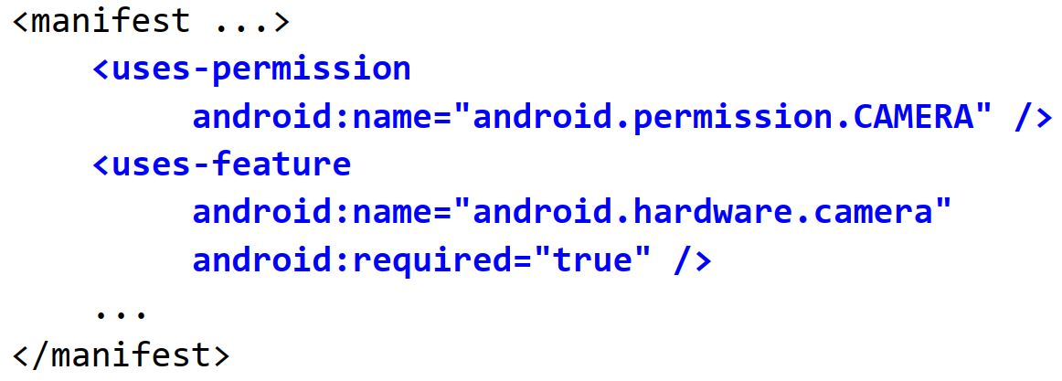
Requesting camera permission
If your app uses the device camera, you must explicitly state that it will use that hardware in your app's AndroidManifest.xml file.

Slide 4
AVD and camera
It is difficult to emulate a camera in the Android Virtual Device.
In AVD Manager, you can try setting the device to use your laptop's webcam as the virtual camera, but it may crash.
– AVD Manager -> Edit -> Advanced Settings -> Camera
Alternatively, just deploy your app to a physical device to test camera functionality.

Slide 5
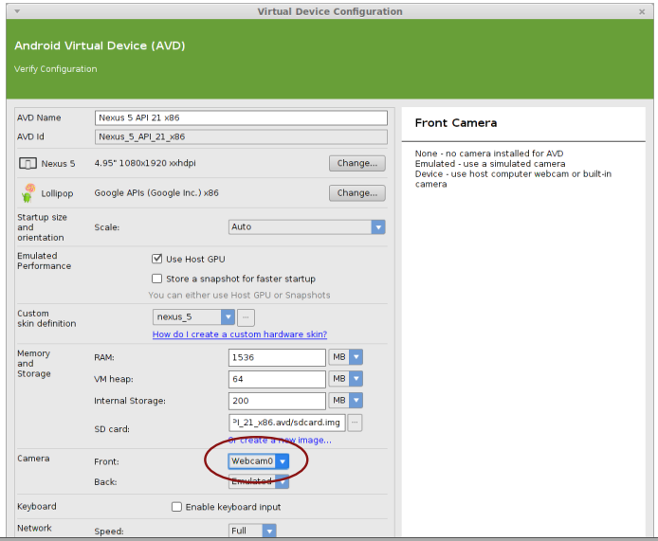
AVD and camera

Slide 6
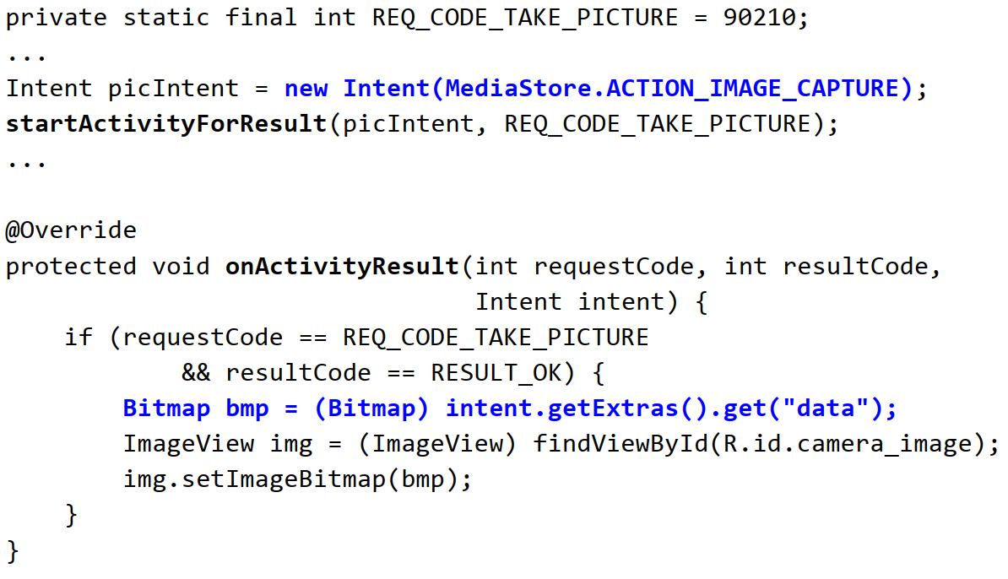
Camera code example
Example that takes a picture and places it into an ImageView:

Slide 7
Thank you!
Any Questions???

